Slide 1
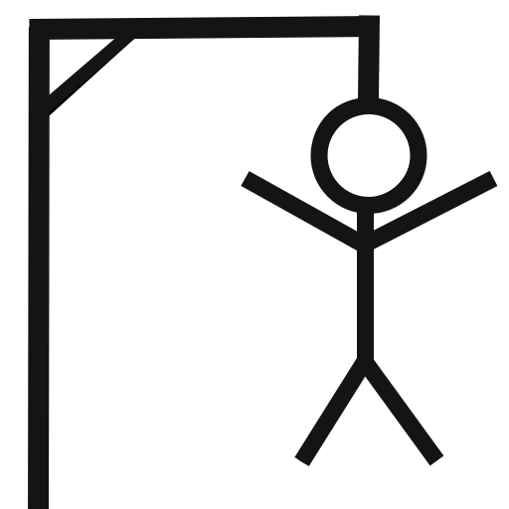

Project 1 : Hangman Game

Slide 2
Organisation
Team : Angela Salgado & Aadil Ben Rachid
Jira Software is designed to help teams of all types to work and manage a project.

Slide 3
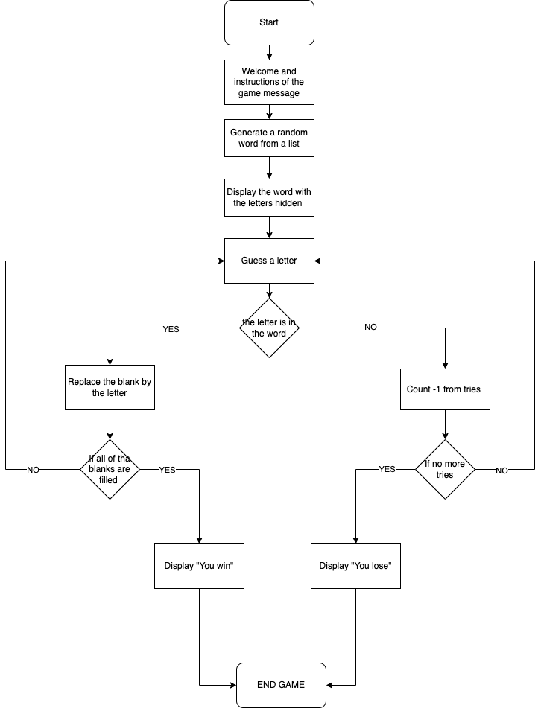
FlowChart

Slide 4

Code Presentation
Démo

Slide 5
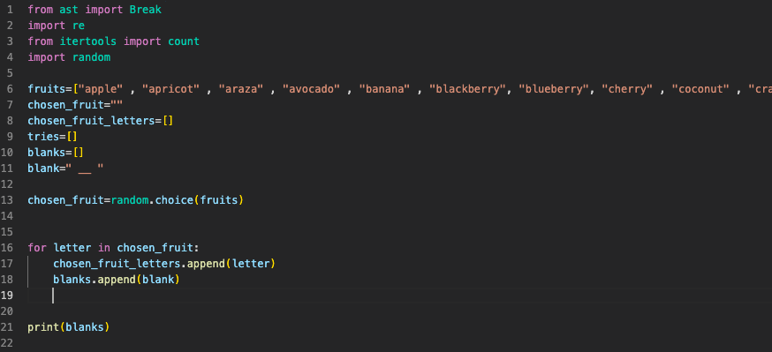
Q & A

Slide 6
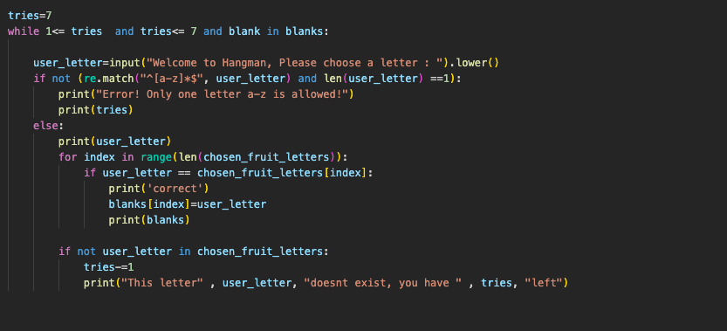

Slide 7
